Slide 1
Kandis Lamke
Ruben Garcia
April 3, 2020

Slide 2
Agenda
Notes:
Outline Agenda

Slide 3
Professional profile
Professional Experience
Chief Operating Officer
Controller
Accounting Manager
Entrepreneur
Education
Bachelor of Arts – Accounting Major
Licensed CPA
Kandis
Lamke

Slide 4
Professional profile
Professional Experience
Education
Ruben
Garcia

Slide 5



Project introduction and Background

Slide 6


Industry:
PEO - Professional Employer Organization
Definitions:
WSE – Worksite Employee. Employees under the co-employment agreement that are supported by the payroll and human resources functions of the PEO.
Internal EE – Internal employees of the PEO that support clients and employees under the co-employment agreement.
Notes:
Project Summary – Domain Knowledge and Insight into the PEO Industry and standard benchmarks, etc

Slide 7
Project Methods
Notes:
Languages and methods used in the analysis

Slide 8
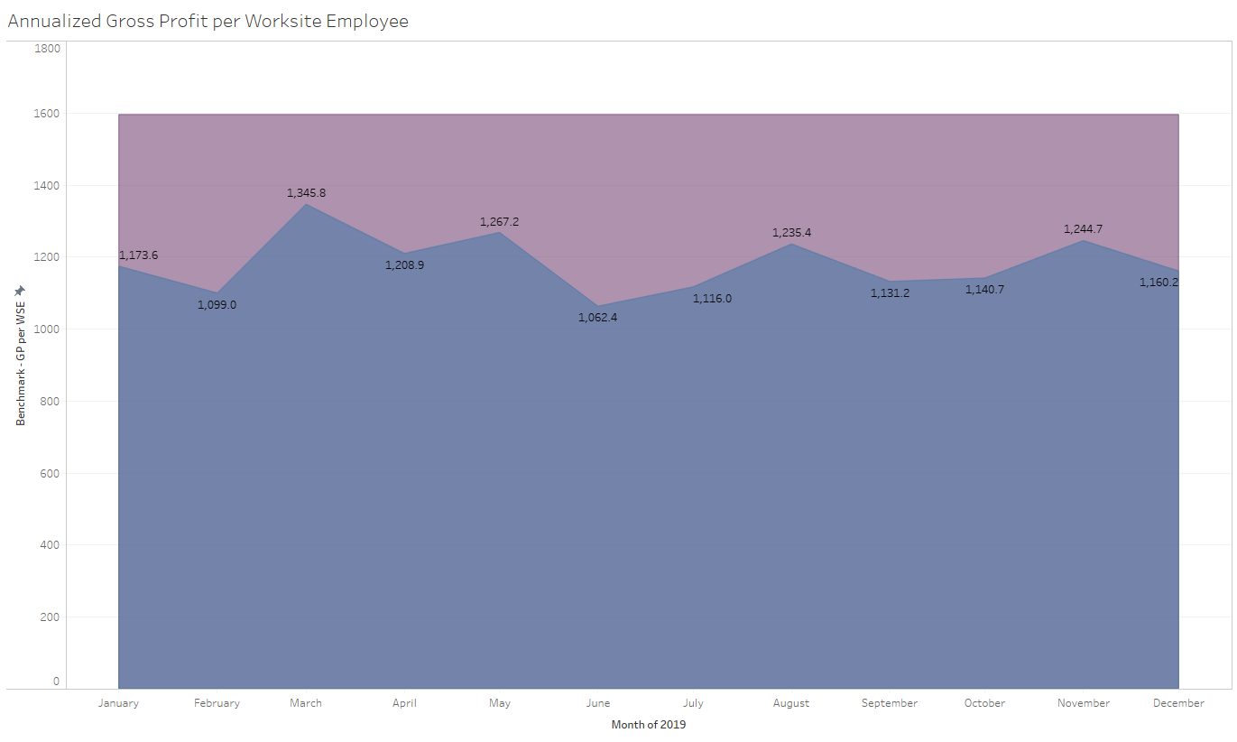
Project results

Slide 9

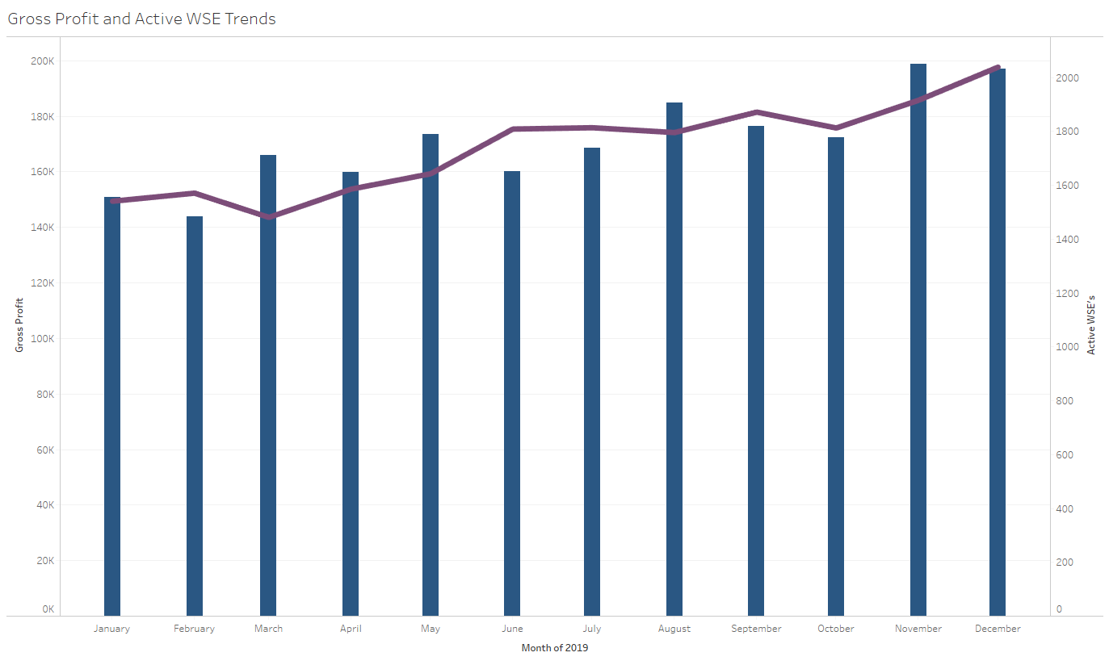

Slide 10
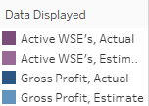
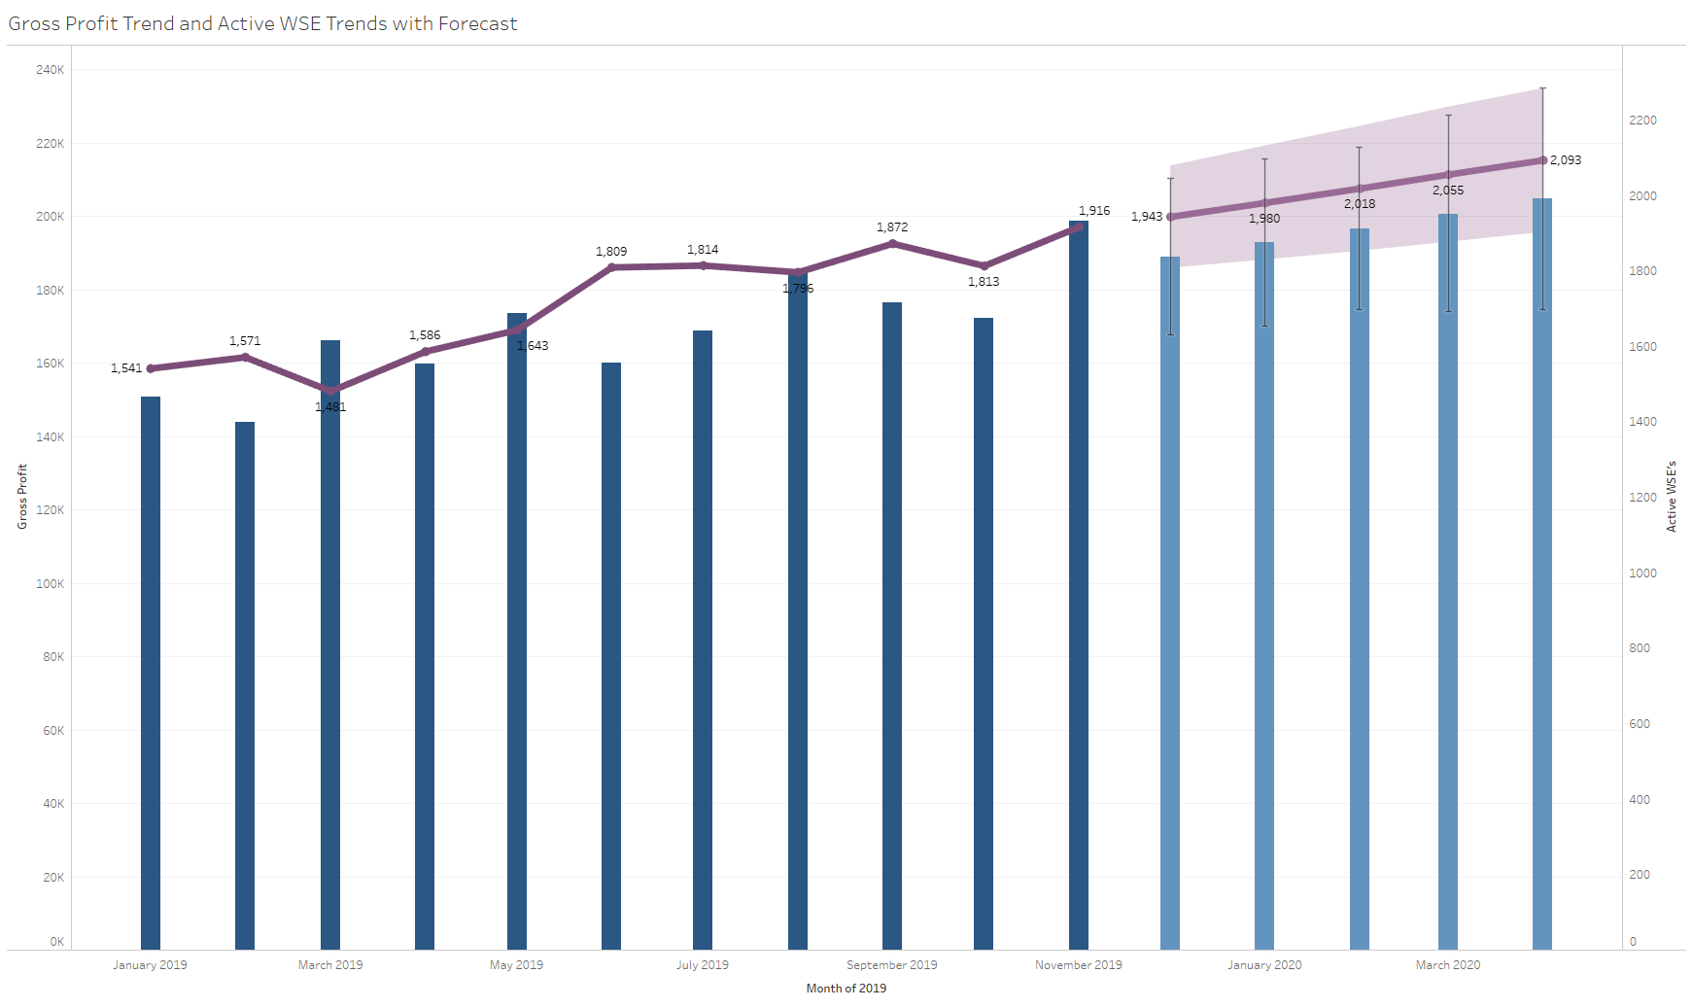
Project results

Slide 11

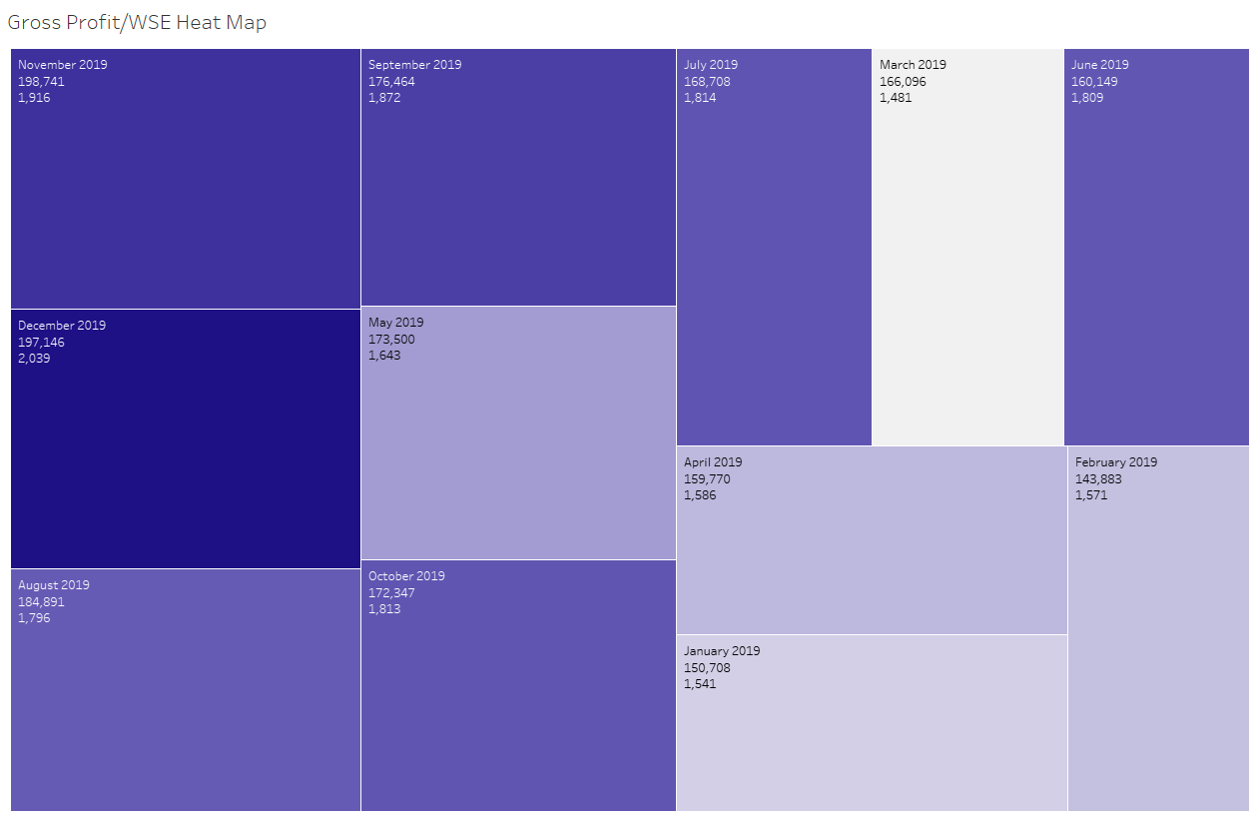
Project results

Slide 12
Project results

Slide 13
Project results

Slide 14
Project results

Slide 15
Project results

Slide 16
summary

Slide 17
Conclusions

Slide 18
next steps

Slide 19
QUESTIONS?

